Slide 1
Predicting occurrence of major accident
by
Hariharan Devarajan

Slide 2
Task
The task is to create a model which could predict whether major accident would occur. Here major accident is defined as more than one vehicle colliding. The motivation behind this task is the fact that accidents in Illinois state are generally major and these are only increasing every year. So analyze and come up with a model which could predict and hence could describe patterns which help reduce accidents by proactive measures. The Problem is a classification problem to identify whether major accident would occur or not. The fact that it will need to analyze both conditions of roads and also driving make this an interesting problem.

Slide 3
Dataset
I have got the crash data of 2014 year
The dataset has 292019 records with 80 features.

Slide 4
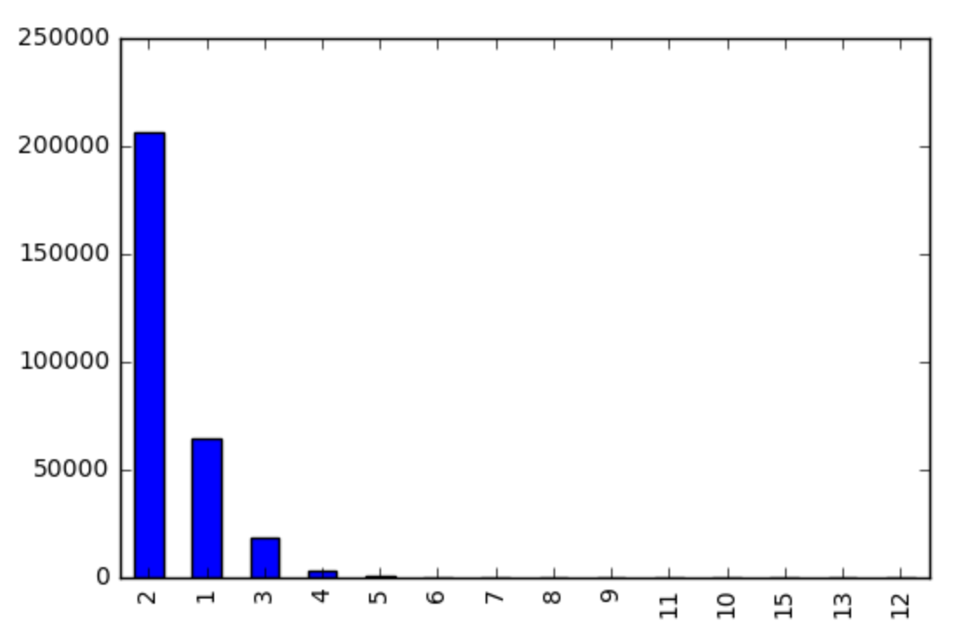
Visualization of the Class

Slide 5
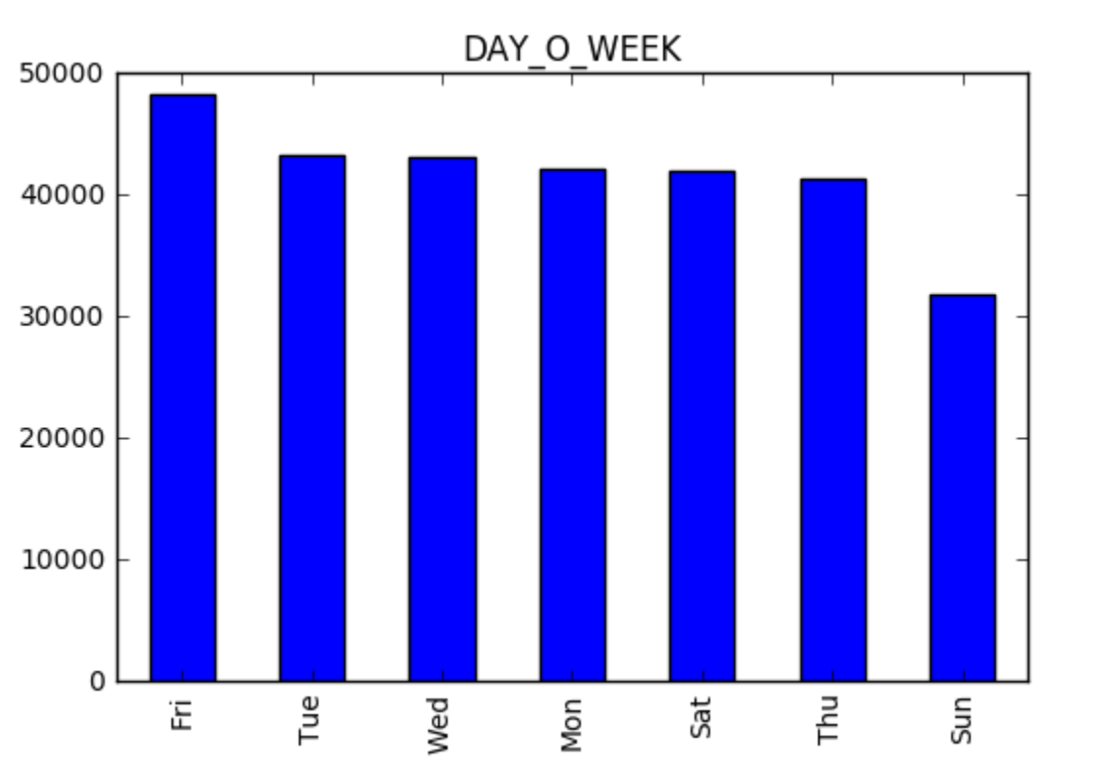
Visualization of one feature

Slide 6
Model Selection Results
The performance measure for this I chose is accuracy and AUC because this model predicts whether major accident would occur or not and for this reason evaluating on the basis of its accuracy is most important.
I used train-validation-test as I had a huge dataset and running cross validation on it would take a lot of time
Results are one the next slide

Slide 7
Model Selection Results
Model | Parameters | Performance
Baseline | majority class | 78%
Logistic regression |  | 78.28%
Random Forest Classifier |  | 84.75
Ada Classifier |  | 87.47
Bagging Classifier |  | 87.34
Extra Trees Classifier |  | 86.5
Gradient Boosting |  | 87.73
Gradient Boosting | Number of trees:500 Loss:deviance Learning Rate:.3 Max Depth: 3 Sample Split:2 Min Sample Leafs:10 Sub Sample:1 Max Features:auto | 88.4

Slide 8
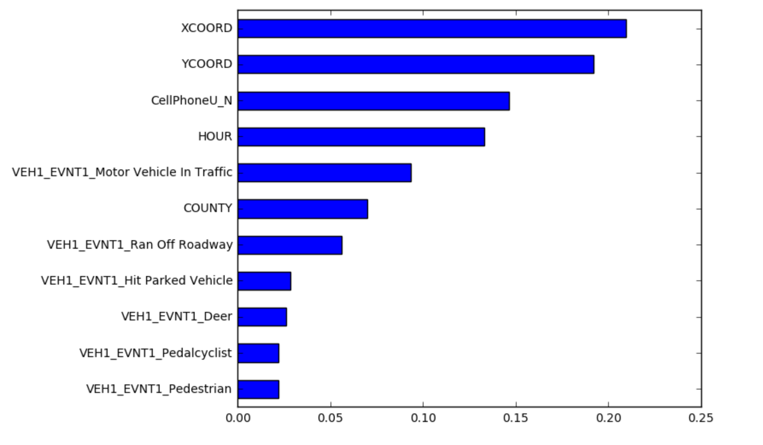
Top Features

Slide 9
Interesting/unexpected cases
The interesting observation from this model was that major accidents are located over particular region. This was derived as the top important features were coordinates. This could help analyze an mark certain zone for careful driving and limits.

